Slide 1
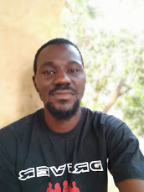
Introduction: Name
Photo
Motivation | Acquiring knowledge and skills in machine learning with python, for data science and AI.
Dream/Career | Working as a data scientist with AI projects in an international or local IT company and I want to start up a software developing company.
Programming Experience | Basic HTML, CSS
Application Idea | Basic wed development.
Expectation for DIVE INTO CODE | Time and patience in lecturing and easy to understand tutorials especially video tutorials, and a recognized official certificate.
Worries/Concern | No mathematical and statistical knowledge and poor internet connectivity.
Commitment | I will study and practices 2 hours a day or even more.

